Slide 1
Handling Sections and Reasons with ease
With
Iliana Visser

Slide 2
Overview
Each semester, Trac users are tasked with the semester changeover. Sometimes a new center is added that specializes in particular courses. In this session, we will explore the management of sections and reasons, two important pieces of the Trac system, to ensure smooth transitions all around. Whether it is manually enrolling students in sections or troubleshooting why students cannot select a subject we will cover the key aspects of these functions.
Also, it is key to make sure that the reasons are set up correctly in order to track why students are coming in to your centers. In this session, we will learn how to effectively set up, activate, and customize reasons to best fit your needs. By the end of this session users will know the differences and relations between sections and reason in the Trac system.

Slide 3
Creating and Activating Sections
Importing Sections
Have your IT send the current course files to your Trac system nightly.
Creating Generic Sections
In the Sections Tab -> Click New -> add the title in the “Sect Term” -> leave the “Term” as 0 -> Check “Non-Enrolled (Available to All)” -> Save.
Examples: Other, Workshop, Non-Enrolled

Slide 4
Activate Sections and Consultant Specialties
For sections every semester
You will need to activate the section for each subcenter
For consultants
You will need to transfer their sections specialties

Slide 5
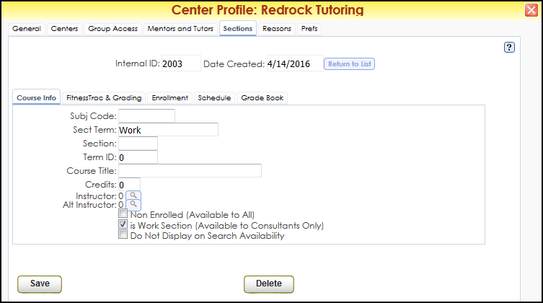
Work Sections
Allows you to have your Consultant record their work time in the Trac application. This is for Payroll or timesheets.
Sections Tab -> Click New -> add WORK in the “Sect Term” -> leave the “Term” as 0 -> Check “is Work Section (Available to Consultants Only)” -> Save.

Slide 6
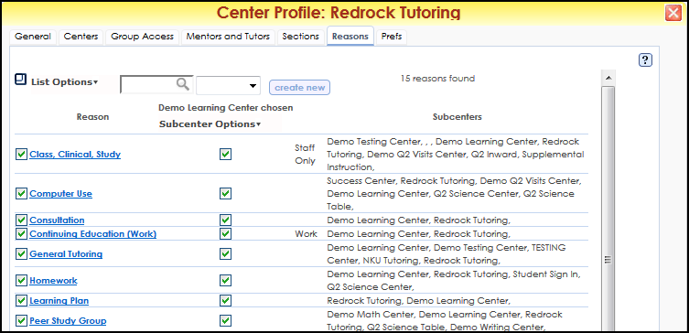
Creating and Activating Reason
Creating Reasons
Reasons Tab -> Click New -> add your Reason -> Save.
Examples: General Tutoring, Advising, Computer Use, Workshop, Orientation
Activate Reasons per Subcenter
Reasons Tab -> Subcenter Options -> Click on the subcenter name -> Check box in the middle box to activate the sections one by one.

Slide 7
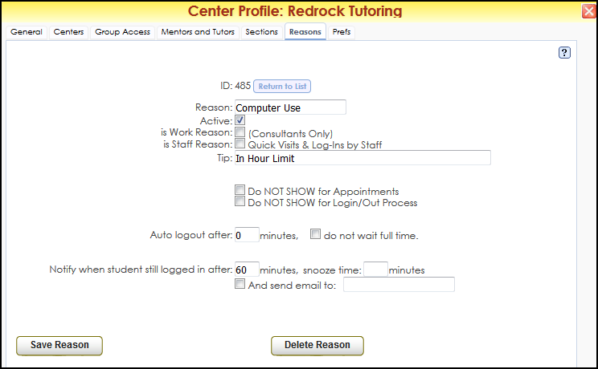
Reason Options
There are a few option that allows you to manage the reasons, such as Auto Log Out, Do Not Show on schedule or even adding a tip.

Slide 8
New Systems and New Semesters Focus Path
9:00am Hopi | Preparing for a Successful Semester Switch
10:00am Papago | Fast-Track Your Center Profile Setup
11:00am Papago | Handling Sections and Reasons with Ease
1:00pm Papago | Consultant Profile Management and Setup

