Slide 1
Geek Speak: The Tech Session
Keegan Johnson and Jodie Huddle

Slide 2
What this session is all about…
This session is dedicated to more technical aspects and setup of your Trac system.
Installation
Imports
Mailserver
Authentication
Encryption

Slide 3
Installation
Redrock Software provides a download link.
Once your Trac system is unpacked, it will install into a single directory (TutorTrac, AdvisorTrac, FitnessTrac).
The default location is C:\TutorTrac
Review prefs.ini to verify static IP address, ports and https settings.

Slide 4
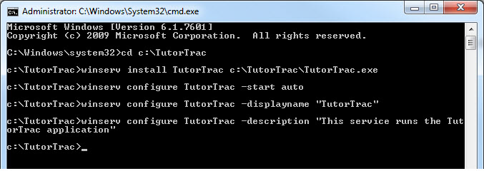
Installing as a Service
To set up your Trac system as a service,
we use a utility called Winserv.

Slide 5
Students and Courses Import
Please provide sample files with 5-10 lines and header rows with the fields you would like to import.
Set-up to create daily
Verify ftp import file drops into Trac system import folder
Import Script (by Redrock)

Slide 6
Mailserver and Email Tool

Slide 7
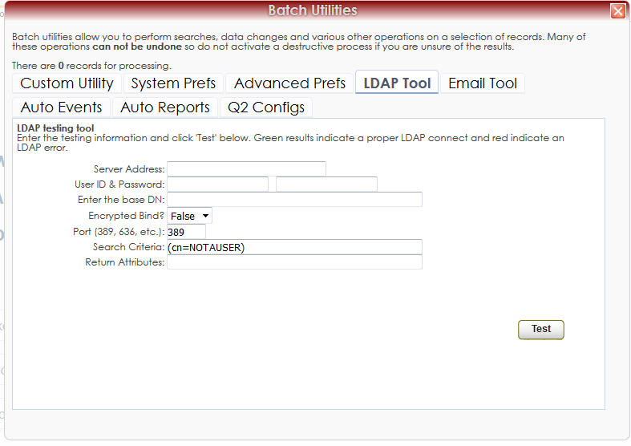
Authentication
Authentication is one of the key components in allowing students to book appointments online. It also allows your users and consultants to use their campus credentials to sign in to your Trac system. The most common authentication types are:
LDAP/Active Directory connection
CAS Authentication
SAML Authentication
LDAP Test Tool

Slide 8
Encryption
Redrock utilizes Stunnel, a encryption tunneling application, to implement Apache/.x509 compatible certificates.
Redrock can provide CSRs and keys for you to purchase a certificate from your trusted CA.

Slide 9
Questions
What technical questions do you have?
How can I help you?
kjohnson@go-redrock.com
877-303-7575 ext 203
Be sure to join us for CrossPIT/Hula and Dinner later tonight.

Slide 10
Handouts
Imports
Prefs.ini

