Slide 1
Maximizing Your Advisement Services
An AdvisorTrac Perspective

Slide 2
Agenda For This Session
AdvisorTrac Use in Advisement
Testimonials!!!
About John Jay
Electronic forms- paper filing system gone
Online appointment scheduling- long lines gone
Kiosks- no more name calling in the lobby
Record each contact with students
Automated reports- just a weekly email
Advisors have full control of their availability (block times)
Students no longer missing appointments (reminders)
Student Population at John Jay
Record, Connect, Report, Success
Why AdvisorTrac?
Demo
There is more you can do….

Slide 3
AdvisorTrac Use in Academic Advisement
Appointment scheduling
Recording Visits and Notes
Viewing documents
Outreach and Assessment
Reporting

Slide 4
About John Jay
One of the Senior Colleges in CUNY
Academic Programs
31 Majors- CRJ (BA/BS):41%, FOR PSY: 17%
40 Minors
13 Master’s Programs- PAD:43%, CRJ:24% , FOR PSY:15%
2 Doctoral Programs
Student Enrollment
13, 000 Undergrads and 2,000 Graduates

Slide 5
Student Population Advised Primarily With AdvisorTrac
Freshmen- incoming also
Transfers- including CUNY Justice Academy
Probation
Readmit
In-service
Veterans
Major Advisor (CJBS)

Slide 6
Trac Usage at John Jay
Who Uses AdvisorTrac Profiles?
Academic Advisement
Graduate Studies
Enrollment Management
AdvisorTrac
Sage
SurveyTrac
Text Option

Slide 7
Record
Track all student interaction online (online, phone, in person)
Notes
Store notes on student interaction (walk-in, quick visits or even batch visits)
Notes easily accessible for all to view and print
Documents
View all relevant advising forms/documents immediately after upload
Each document is attached to the student record
Able to track student progress from freshman year to graduation
Students can view academic plans online

Slide 8
Connect
Appointment Scheduling
Online
In person
Kiosks
Staff supported
Self service
Communicate
Emails
Messages
Feedback
Surveys and questionnaires

Slide 9
Report
Interaction collected over different time periods
Student data
Appointment data
Visit data
Consultant data
Center usage
Assessment
Monitor specific student groups
Student lists
Watchlists
Business Practices
Staffing
Office Hours

Slide 10
Success
Connect
Appointment Scheduling
Most students schedule appointment online
Less phone calls
Better attendance rates for appointments
Record
Transparency of advising notes
Immediate documents at advisors and students finger tips
Report
Immediate center usage (peak time, relevant appointment information (missed, etc.,), visit data)
Staff Efficiency
Automation (emails, reports, messages, feedback)

Slide 11
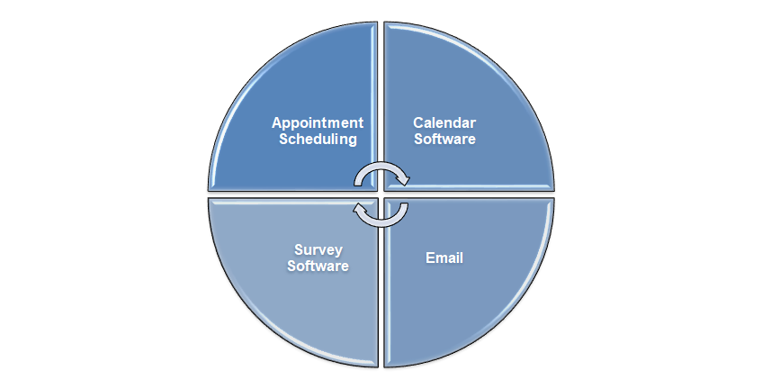
Why AdvisorTrac?

Slide 12
AdvisorTrac Around John Jay
Jay Express
Appointment scheduling and walk-ins
FInancial Aid
Financial Aid Workshops
New students
Continuing students
Degree Concerns (Triage)
Registrar
Advisement documents
Degree Concerns (Triage)
Prism
Student data not collected in SIS

Slide 13
Different Ways of Using AdvisorTrac
Gym registration
Kiosk
Next Day list
Faculty Advisement
Advisement in major pilot
Department Advising
Student Outreach
Outreach team efficiency
Custom Fields
Referrals
Student follow up -CJBS
Master file
Documents

Slide 14
Thank you!
Live Demo?

