Slide 1
Utilities, Preferences, and Events…Oh My!
Keegan Johnson

Slide 2
Session Content
In this session we will cover advanced aspects of the Trac system. We will take a look at administrative tools that you use can to manage your system. In addition we will cover system preferences that will allow you to further configure your Trac system to your needs.

Slide 3
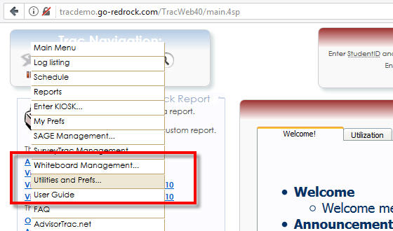
Overview
Utilities
System Preferences
Advanced Preferences
Auto Events

Slide 4
Overview

Slide 5
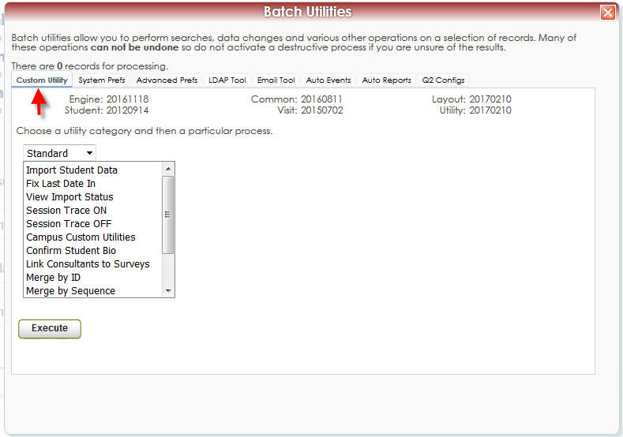
Custom Utilities
As a System Administrator there are numerous utilities at your disposal. Many of these utilities are available to regular administrators as well.
We’ll start with the Custom Utility Tab.

Slide 6
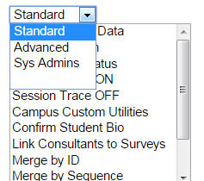
Custom Utilities
In the Custom Utility tab there is a drop down menu that contains different categories of utilities including Standard, Advanced, and Sys Admins.
While some utilities may appear in multiple categories each category may contain particular commonly used utilities.

Slide 7
Custom Utilities
Here some notable utilities from each category that we will take a look at:
Standard
Import Student Data
View Import Status
Reset Center Status / Missed
Copy Specialties
Resend Appt Confirmations
Advanced
Login as User
Sys Admins
Upload Campus logo
Reset Color Data
Reset myPrefs
Activate Module
Duplicate Group

Slide 8
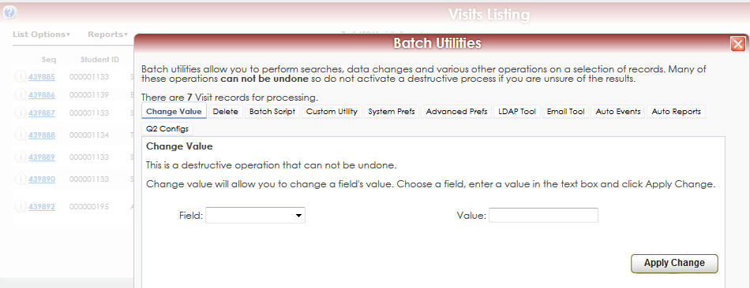
Custom Utilities – Change Values
If you were on a Student, Visit, Registration, or even Section listing before opening your Utilities and Prefs you window may look slightly different. It will include the Delete and Change Value tabs. Using these tabs you can manipulate data that is on the current listing.
You might use the Change Value tab to correct a batch of incorrectly entered visits!

Slide 9
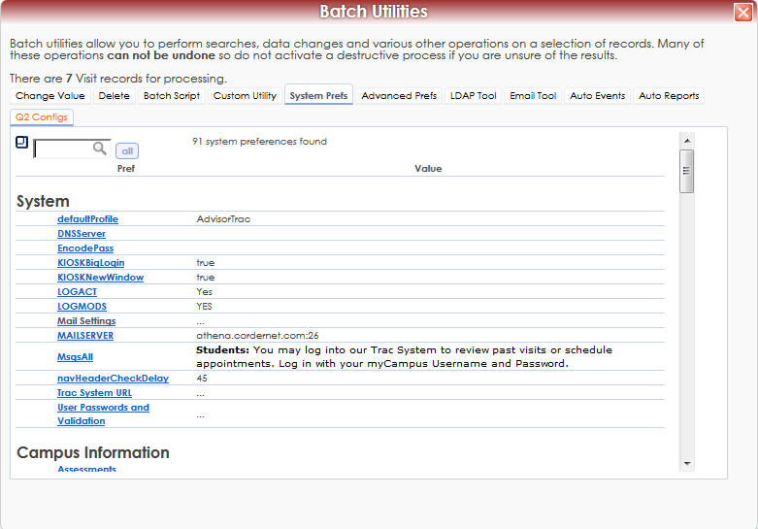
System Prefs
The System Prefs tab contains preferences dealing with student access, displayed messages, mail settings, the current term and more.

Slide 10
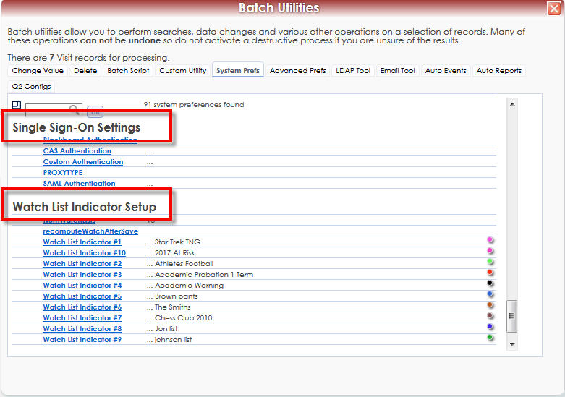
System Prefs
System Preferences are organized into categories. Commonly used Categories include:
System
Campus Information
Student Data
Single Sign-On Settings
Watch List Indicator Setup

Slide 11
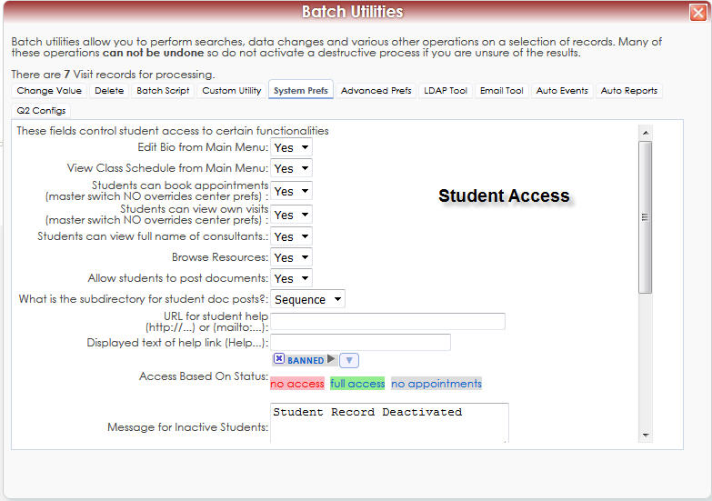
System Prefs
Key System Prefs
Student Access
Mail Settings
CurrentTerm
SemesterStart
SemesterEnd

Slide 12
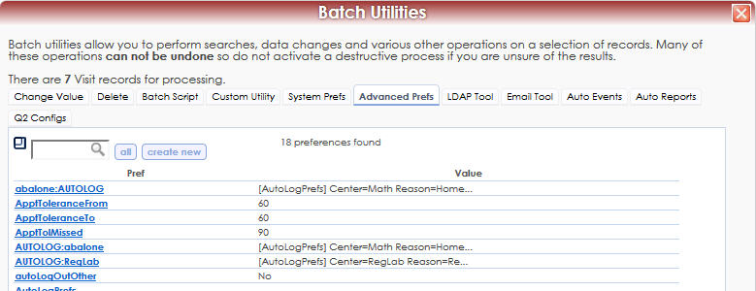
Advanced Prefs
The Advanced Prefs tab contains most of the same preferences as System Prefs + more.
These preferences are accessed by searching for them first. Some preferences such as missed appointment windows can be found here.
Results shown for “@tol” search

Slide 13
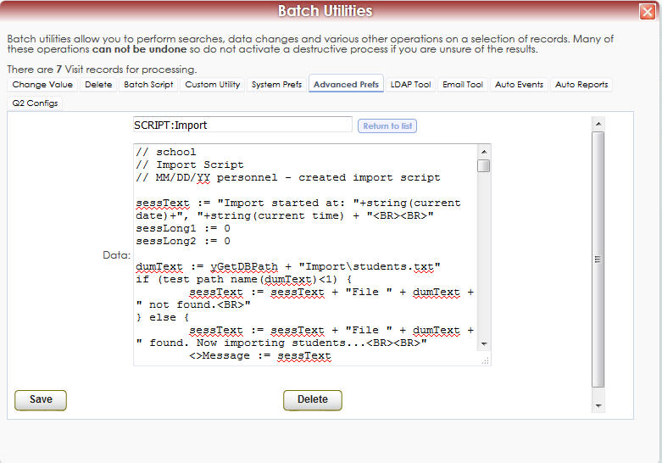
Advanced Prefs
Searching using the @ symbol can help you find preferences.
Here is an example of the SCRIPT:Import preference that contains the custom import script created by Redrock

Slide 14
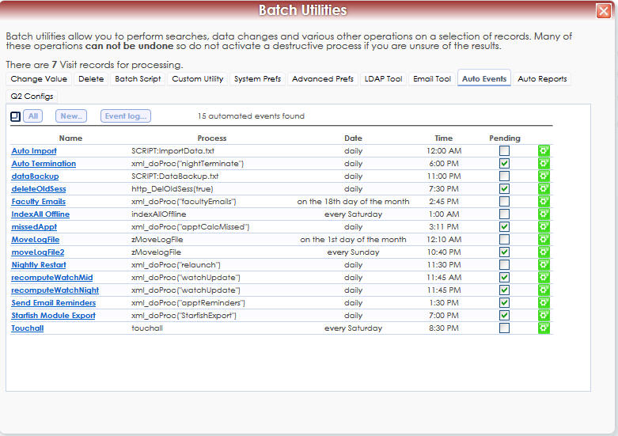
Auto Events
The Auto Events tab is where you can manage the various automatic processes in your Trac system.
These may include imports, email reminders, exports, and other tasks.

Slide 15
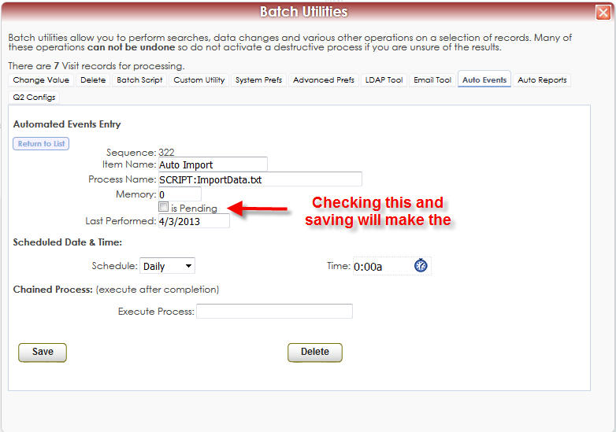
Auto Events
Clicking on the name of an event will bring up it’s entry page.
Here you can set the parameters for when and how often your event runs.

Slide 16
Ask Redrock!
Not sure what a preference does or if it exists? Ask Redrock!
Anyone at Redrock support will be glad to help you review some preferences to make sure your Trac system is configured correctly.

Slide 17
Questions?
You can visit the helpdesk for quick preference questions.
Some of the more technical tabs of the Utilities and Prefs will be discussed in Geek Speak!

