Slide 1
Wrap-Up and Q&A: Identifying Specific Student Populations
Jennifer Turley
Redrock Software

Slide 2
Overview
In this Wrap-Up Session we will talk about the importance of utilizing the different ways in your Trac System to pull specific Student Populations and use those populations to add students to Watchlists and maximize the ability to quickly identify a student and their specific needs. We will also answer any questions that may have come up while attending any of the following sessions.

Slide 3
Communication and Retention with SAGE
What student information qualifies the need to create a referral?

Slide 4
Navigate Your System Like a Pro!
Today
This Week
This Month
This Semester
Yesterday
Last Week
Last Month
Tomorrow
Next Week
Rsn= (For a Specific Reason)
Cons= (For a Specific Consultant)
Sect= (For a Specific Section)
Ctr= (For a Specific Center)
Using Trac Navigation to search for students.
Custom lists
Special Date Search Options and Other Visit field search options.
Trac Navigation Search options (@, =, #, >,<,; and …)

Slide 5
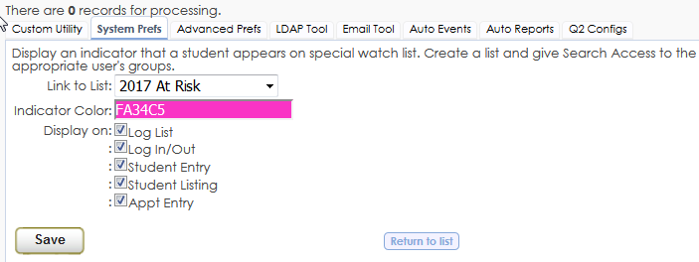
Power Search, Lists, and Watchlists
Use Search, Power Search and Utility Search to find specific populations of students and add them to a watch list
Use System Prefs to set up watch list indicators.
Use Watchlists to quickly identify specific students

Slide 6
Student Access and View in Trac
Why do we want students to access Trac?
What can students access in Trac?
How can students access items in Trac?
What can students do in Trac?
Manage appointments
View visit history
Post documents
Sign up for text alerts
Answer surveys
Reserve resources
Join online sessions
View messages

Slide 7
Communicating With Busy Students through Emails and Text Messages
How to search and send out text messages and emails to students
Power Search
Utility Search
Standard Search
Communication to students is key!

Slide 8
Reports for Specific Student Populations
Can I run reports for specific students?
List reports
Adding students to lists and running reports based off of those students

Slide 9
Survey Says…
Search for specific populations of students and send surveys.
Surveys can be viewed when the student logs in, logs out, goes to schedule an appointment, or can manually be sent to their email.
Restrict surveys to only send for specific Subject or Reason

Slide 10
Conclusion
Any Questions?

