Slide 1
10 Steps to Prepare for a New Semester
With
Iliana Visser

Slide 2
Overview
At the end of the semester, there are a few steps to transition to the new semester.
Your Trac system identifies the active term to specify which course registrations are active.
Since your imports contain student registrations specific to a term, the TIMING between changing your Term Code and importing your registrations is important.

Slide 3
STEP ONE: Import Files
First Time?
The Trac application can import data from any source as long as it is provided in the correct format. The data needs to be provided in a flat file format and a sample needs to be sent to Redrock HelpDesk to create your import.
The order and delimiter of the fields is completely up to your preference. However, the format, order, and delimiter of the fields must remain consistent with every import.
After import set up?
The format, order, and delimiter of the fields must remain consistent with every import. Redrock Software recommends that the student demographic data be imported with the students' course registrations and course instructors.

Slide 4
STEP TWO & THREE: System Prefs
Change The Term Number
Needs to be numeric and increasing
Summer = 201902, Winter = 201903
Change Semester Dates
For new Semester to have the Auto recompute date updated for reports and searches
SemesterStart
SemesterEnd

Slide 5
STEP FOUR & FIVE: Import Info
After the term change you will need to run the import manually (Sysadmin Rights) OR have the files automatically imported daily, weekly, monthly
If you manually run the import you should confirm that the import process has completed.

Slide 6
STEP SIX – EIGHT: Sections and Consultant
For sections
Globally activate your sections
Then activate the section for each subcenter
For consultants
Add new sections manually to your consultants
OR copy the consultant specialties from previous term to the new term

Slide 7
STEP NINE: Reset Center Status
If you are using the Max Missed preference you need to reset…
System Prefs
“Reset Center Status/Missed”
Center Prefs
Max Missed Date
Reset students status as admins

Slide 8
STEP TEN: Other Settings
Change the dates for “Other Scheduling Block”
Check the text that you may have entered in the Reminder/Cancellation email, in the notice or welcome page

Slide 9
Helpful Links
http://wiki.go-redrock.com/wiki/Changing_Semesters
http://wiki.go-redrock.com/wiki/Importing_Student_Data
http://wiki.go-redrock.com/wiki/TechImport

Slide 10
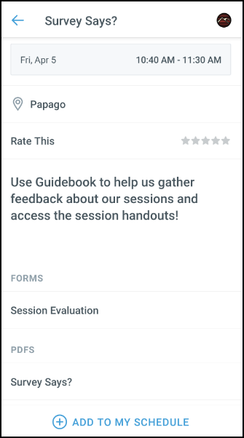
GUIDEBOOK: Session Evaluation and Handouts
After the session you attended to fill out the Session Evaluation:
Click on Session Schedule then the Session Title
Toward the bottom, click on Session Evaluation
Fill the out the Survey and click Submit
Want the handout for the session you just attended:
Click on Session Schedule then the Session Title
Toward the bottom, in PDFS click on the guide you want to download.

