Slide 1
Consultant Profile Management and Setup
Luis Frias
Redrock Software

Slide 2
How we define a “Consultant”
They are typically Tutors and Advisors, but a Consultant can represent any Group that meets or consults with Students.
In order for a User to have their own Schedule, they must be a part of the Consultant Group.
Consultants are uniquely organized within the Center Profile.

Slide 3
Consultant Creation
General Info
Contact Info
Subcenters
Certifications
Section Specialties
Reason Specialties
Messages
Documents

Slide 4
Recording Consultant Hours
A student ID must be linked to the Consultants account.
Consultant will log in and out in the Fashion as students.
Upon login the Consultant will select a Work subject and/or Reason.

Slide 5
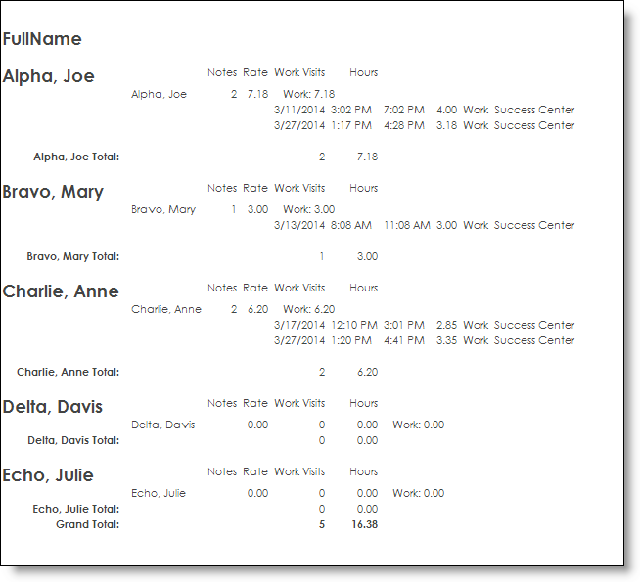
Consultant Based Reports
Consultant Specialties Report
Consultant Appointments/Visits
Consultant/Work Visits By??

Slide 6
On the Go Redrock Conference Guide
Download the Guidebook App on mobile device or tablet
To find the 2019 Redrock Conference Guide:
Enter the passphrase
2019rrconference

Slide 7
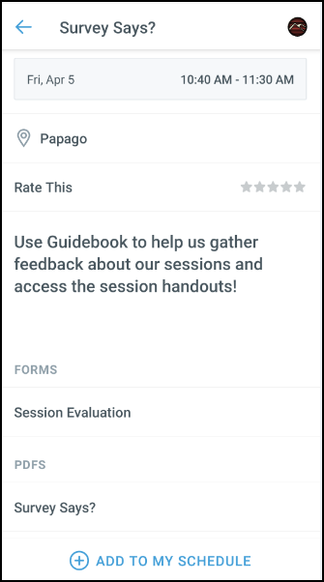
GUIDEBOOK: Session Evaluation and Handouts
After the session you attended to fill out the Session Evaluation:
Click on Session Schedule then the Session Title
Toward the bottom, click on Session Evaluation
Fill the out the Survey and click Submit
Want the handout for the session you just attended:
Click on Session Schedule then the Session Title
Toward the bottom, in PDFS click on the guide you want to download.

