Slide 1
All You Need to Know About Creating Visits
Iliana Visser
Redrock Software

Slide 2
Why Should You Record Visits?
Meaningful Data for Detailed Reports
Track Center Usage
Visit Data Can be Collected by:
Logging Students In and Out
Quick Visits
Batch Visits
Kiosks

Slide 3
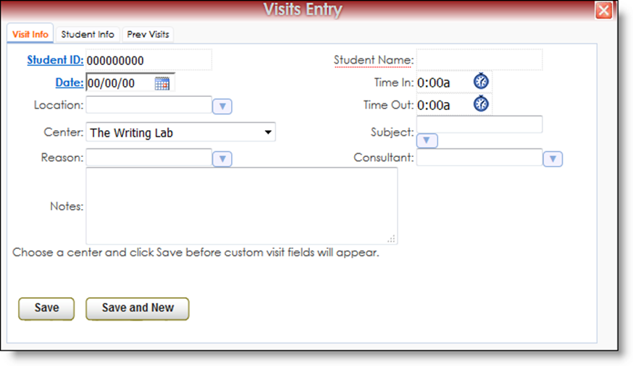
Quick Visits
Allows You to Record a Visit if a Student Forgot to Login

Slide 4
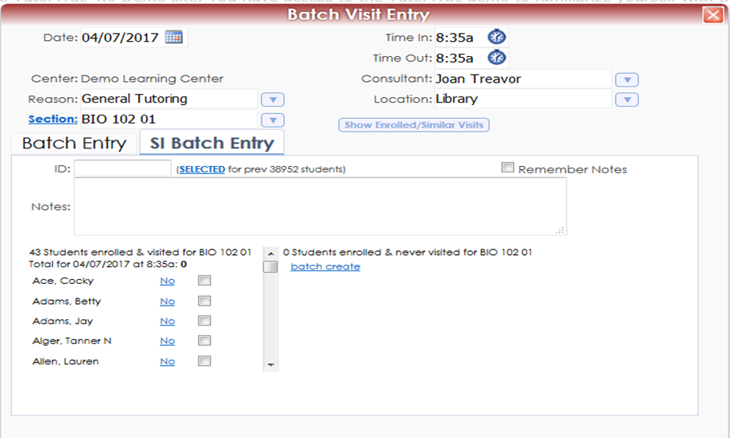
Batch Visits
Allows You to Record a Visits for a Group, Workshop or S.I. Session

Slide 5
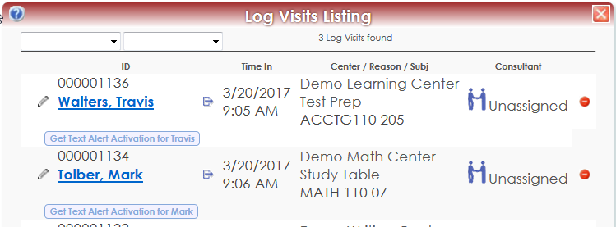
The Log Listing
Digital Sign-in Sheet
Quickly Identify Who is Logged in

Slide 6
Log Listing Settings
System Settings
FormatID
Login Instructions
Profile Settings
Display Subject and Reason when Logging In
Display Subject and Reason in Log List
Auto Terminate on Log List
Group Settings
Barcode/Mag Strip Setting

Slide 7
What is a Kiosk?
Provides Users with a Sign-In Station that can run Independently
Students Sign in When They Arrive and Out When They Leave
The Kiosk Station Does Not Need to Be Staffed or Actively Overseen by a Staff Member
Since it is Primarily Used by Students, Access is Very Restricted

Slide 8
Kiosk Options
Linked Subcenter, Location and Consultants
Show Students
Different Functionalities
In-Out
In Only
Out Only
Wait list
Allow Students to Leave (Text Alerts)
Dynamic Kiosk

Slide 9
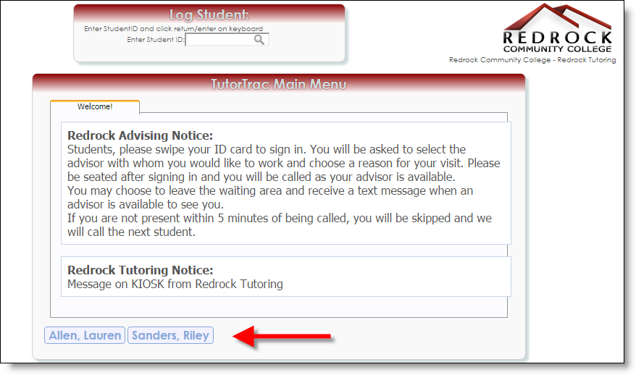
Show Students on Kiosk
Will display the student name on the bottom once they log in and when they leave they can click on their name

Slide 10
Wait List on Kiosk
Will Display the Student Name in a “Waiting List” Format
When Ready to Meet With a Student, the Consultant Can Click on Their Name From Their Computer and the Student’s Name will Be Removed From This List

Slide 11
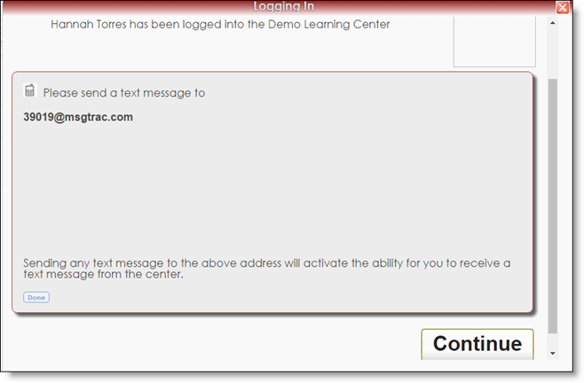
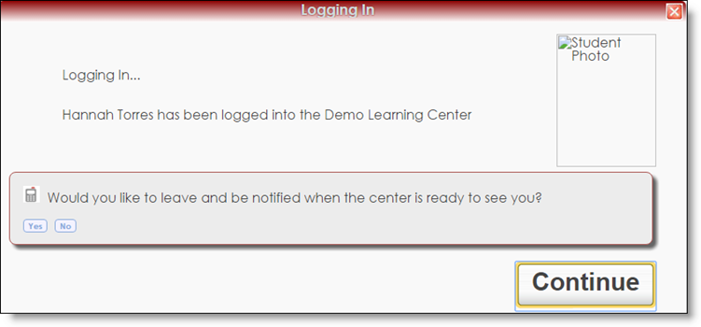
Allow Students to Leave (Text Alerts)
Student must be “opted-in” to receive Text Alerts
If opted-in, students will be asked if they want to receive a text message when the consultant is ready to see them

Slide 12
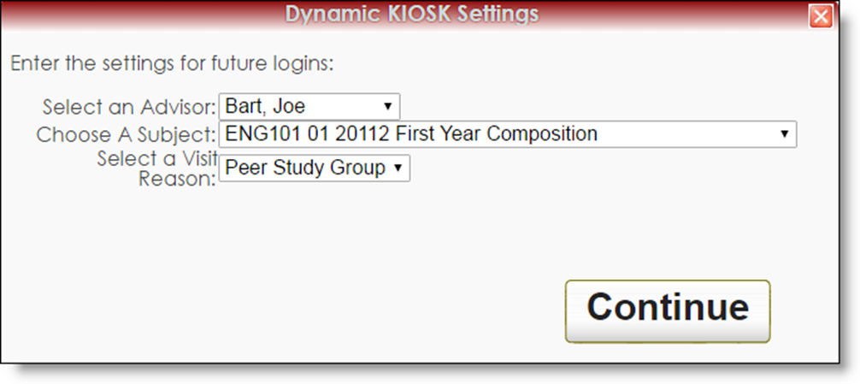
Dynamic Kiosk
Allows Users to Pre-Select Fields on a Kiosk

Slide 13
Kiosk Settings
System Settings
“KioskNewWindow”
“KIOSKBigLogin”
Profile Settings
Custom Questions on Kiosk Only
Notice on Kiosk
Group Settings
Different Kiosk Can be Assigned per Group
Allow User to Search by Name on Log Listing Kiosk

Slide 14
Helpful Links
http://www.tutortrac.com
http://wiki.go-redrock.com
http://wiki.go-redrock.com/wiki/Visits
http://helpdesk.go-redrock.com

Slide 15
GUIDEBOOK: Session Evaluation and Handouts
After the session you attended to fill out the Session Evaluation:
Click on Session Schedule then the Session Title
Toward the bottom, click on Session Evaluation
Fill the out the Survey and click Submit
Want the handout for the session you just attended:
Click on Session Schedule then the Session Title
Toward the bottom, in PDFS click on the guide you want to download.

