Slide 1

Get All the Facts & Figures: Reports at Your Fingertips
with Jodie Huddle

Slide 2
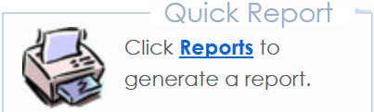
Overview
Trac reports summarize or detail who is getting help for what reasons. You can use this meaningful data to analyze what resources are needed and when they are needed.
Today, we will review:
Data Sources
Dynamic Student List
Simple List Reports
Favorite Reports
Raw Data
Automatic Reports
Trac Report Guide

Slide 3

Data Sources
What information is available for reporting?
Student Bio & Demographic Data
Student Registrations
Available Appointments
Booked Appointments
Visit information

Slide 4
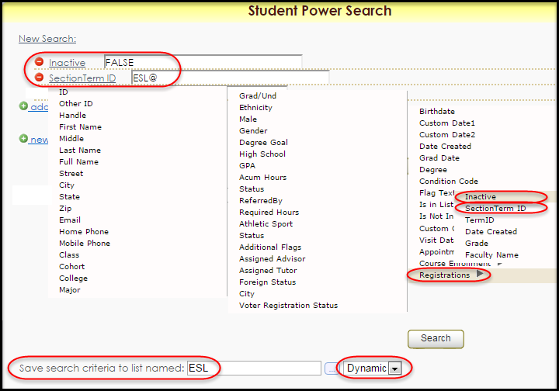
Dynamic List
A custom list is a great way to search and report on a group of students.

Slide 5
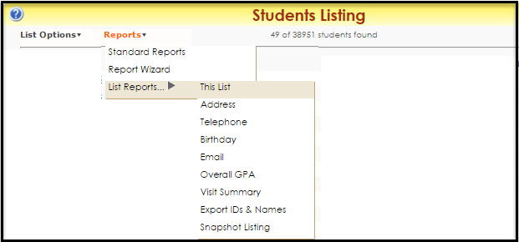
Reports for a Student List
Trac Navigation > Search Glass > Students > ESL > Reports > List Reports

Slide 6


Favorite Reports
Save and name your Favorite Reports
Find them in the Favorites category of the Report Chooser.
Quick access right from the main menu
Share favorites with members of your permission group.

Slide 7
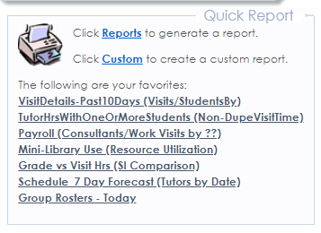
My Favorites!

Slide 8
Raw Data
Get the basic information in a simple format.
Visit Export
Payroll Visits Export
SurveyTrac export
SAGE export
Note: some exports require the
Trac support team to configure for you.

Slide 9
Automated Reports
Trac reports can be automatically emailed to you and your staff on a daily, weekly or even monthly basis.
To set up Auto Reports, your Trac user account must be allowed System Administrative access .
Choose a unique time to run your new Auto Report – don't overlap any other Auto Event or Auto Report process.

Slide 10
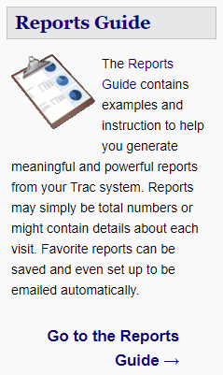
Trac Report Guide wiki.go-redrock.com/wiki/Reports:Main
Get descriptions and examples of available Trac reports.
Need help?
  We can help find a report you are looking for.

Slide 11
Your Trac Data + a graphing software = ?

Slide 12

Your Trac Data + a graphing software = wow!

Slide 13
Reminders
5:30pm – Mat Pilates or Yoga
7:00pm - Dine with Redrock at
The Old Spaghetti Factory

Slide 14
On the Go
Redrock Conference Guide
Download the guidebook App on mobile device or tablet
To find the 2019 Redrock Conference Guide:
  passphrase:
  2019rrconference

Slide 15
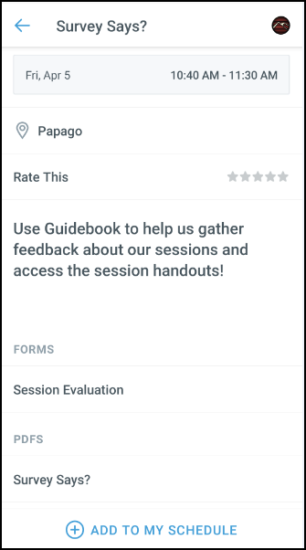
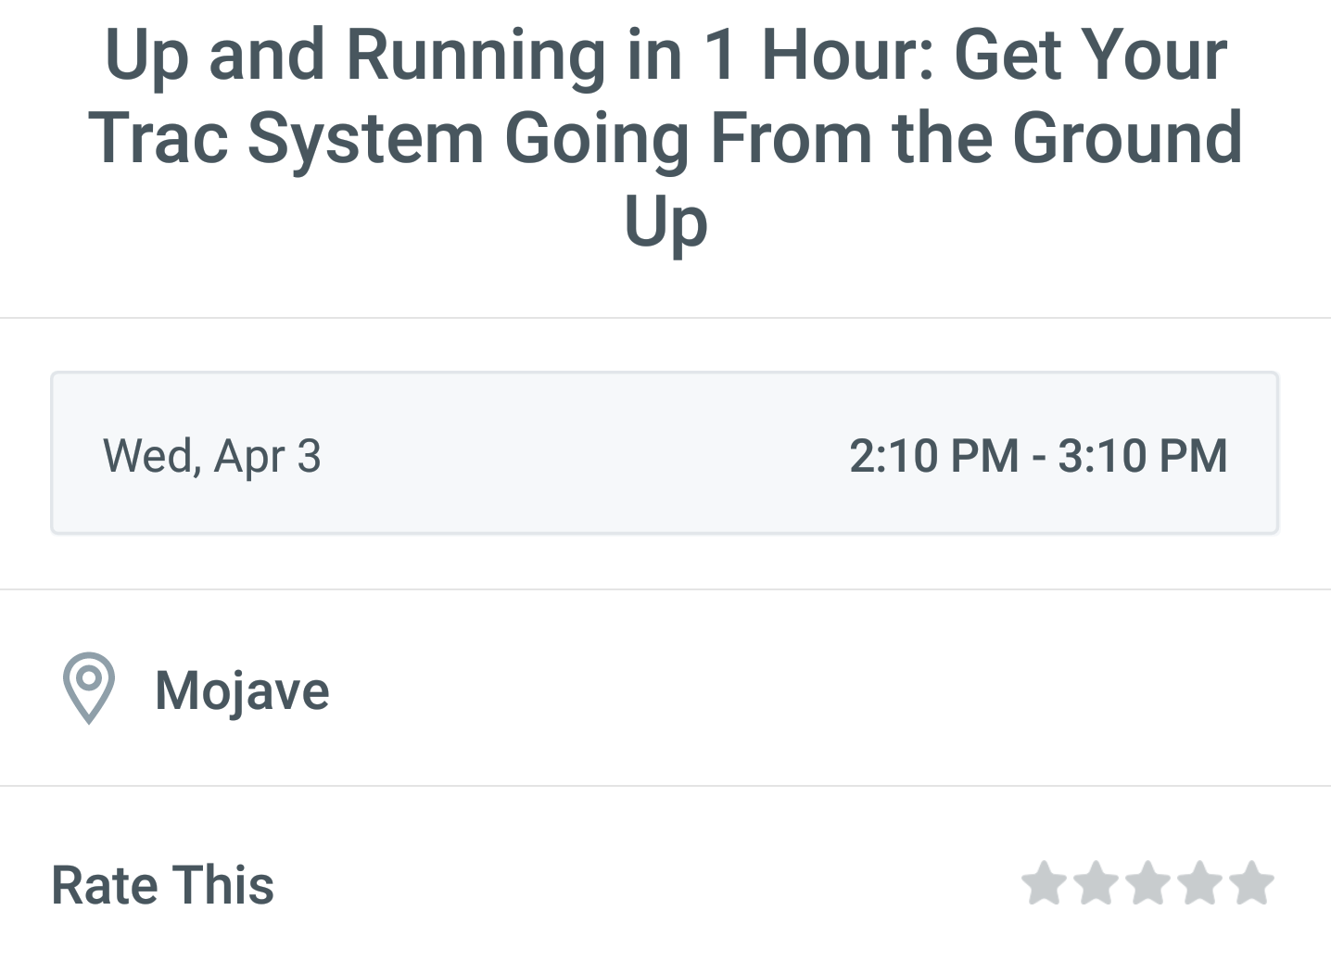
GUIDEBOOK: Session Evaluation and Handouts
After the session you attended to fill out the Session Evaluation:
Click on Session Schedule then the Session Title
Toward the bottom, click on Session Evaluation
Fill the out the Survey and click Submit
Want the handout for the session you just attended:
Click on Session Schedule then the Session Title
Toward the bottom, in PDFS click on the guide you want to download.
Fill Out Evaluation
Get Handouts

