Slide 1
The Many Uses of TutorTrac
Presented by Dr. Latrice Bowman, University of Alaska Fairbanks
lnbowman@alaska.edu

Slide 2
Agenda
Brief overview of our school
Where we started
Where we are now
A look at our programs and TutorTrac Usage
  Math Bridge
  Drop-in Tutoring
  Appointment Tutoring
  Group Tutoring and Reporting
  Tracking grading hours
  Resource Rentals
  Tutor Certifications
Where we go from here

Slide 3
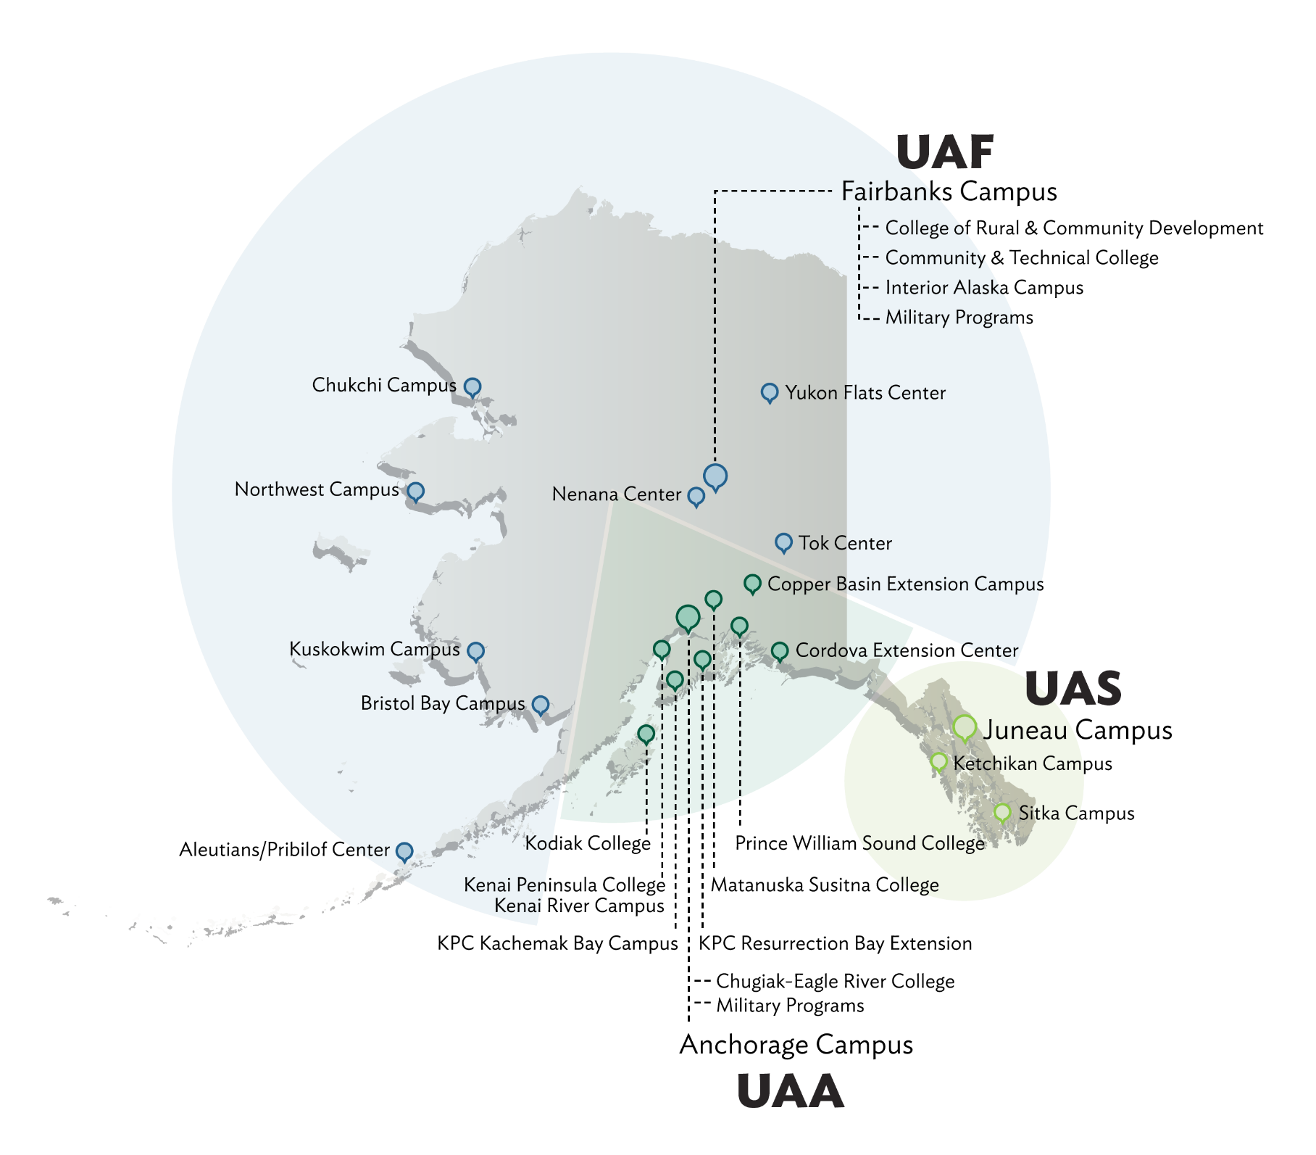
UAF and DMS
UAF
Seven branch campuses that reach across the state
89% of the student body is undergraduate
Enrollment is around 8700
  5500 are in Fairbanks
  62% of these are enrolled in at least one eCampus course
No centralized tutoring or academic success centers
DMS
Currently 17 full time faculty
47 sections of undergrad and grad math and stat classes- includes 13 online courses
Online courses include students from 12 different countries, and 5 continents
Math services coordinator is full-time faculty member

Slide 4
Where we (DMS Math Services) started
20 years ago
8 years ago
Math and Stat Lab
~800 visits per semester
10 undergraduate tutors
5 core courses
All tracking done by hand
Have the Math and Stat Lab and online tutoring
~1200 visits per semester
20 undergrad and grad tutors
Cover all core courses and 2 upper division
Tracking by had and through online platform

Slide 5
Where we are now…Math Achievement services
Math Bridge
Math and Stat Lab
1-1 Tutoring
Online Tutoring
Course Specific Group Tutoring
Grading
“Rentals”
Student Worker Trainings
~2200 visits per semester
25 undergrad and grad tutors and graders
Services for 20 courses
No more tracking by hand!!
Thank You TutorTrac!

Slide 6
Math Bridge
Referrals (soon) and Attendance Tracking
1-credit skills workshops for core gateway courses
Required for
  Previous DFW students
  Students without current placement
Recommended to
  Students with low placement
  Students struggling in 1st 2weeks
TutorTrac used for attendance in these courses
Faculty can refer students (not yet using Sage)
  Missing prerequisites
  Low scores on assignments
  Struggling with study skills

Slide 7
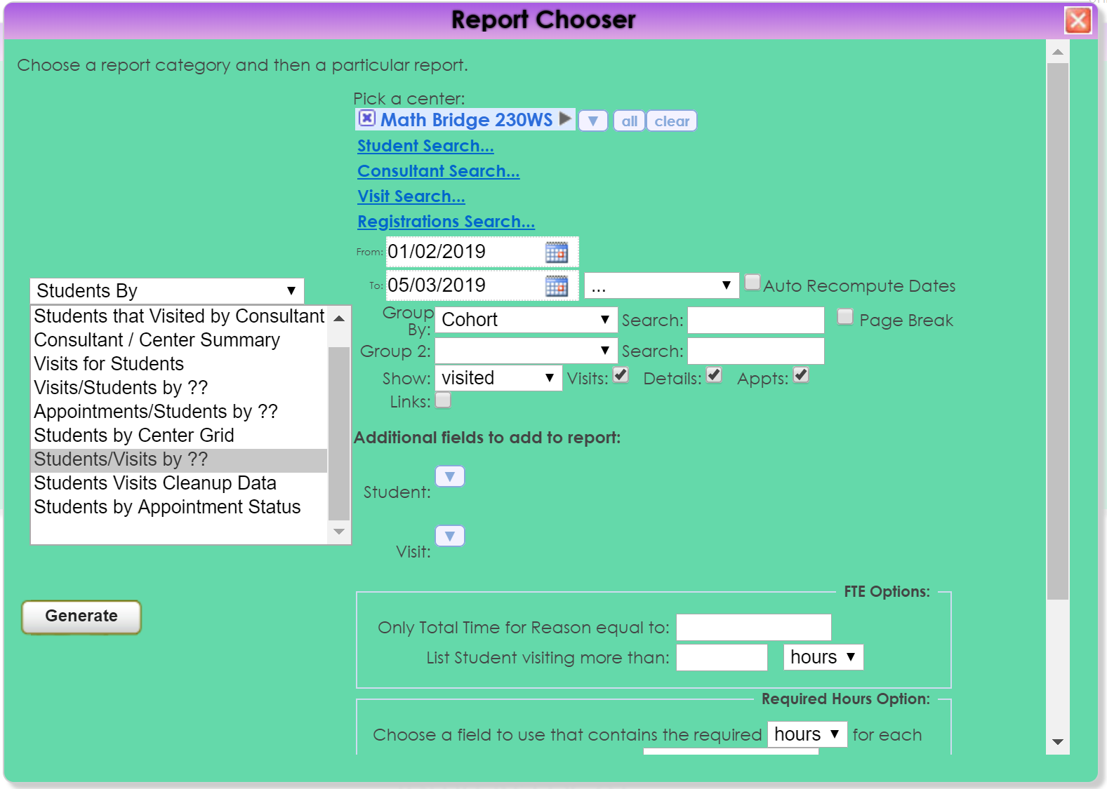

Slide 8
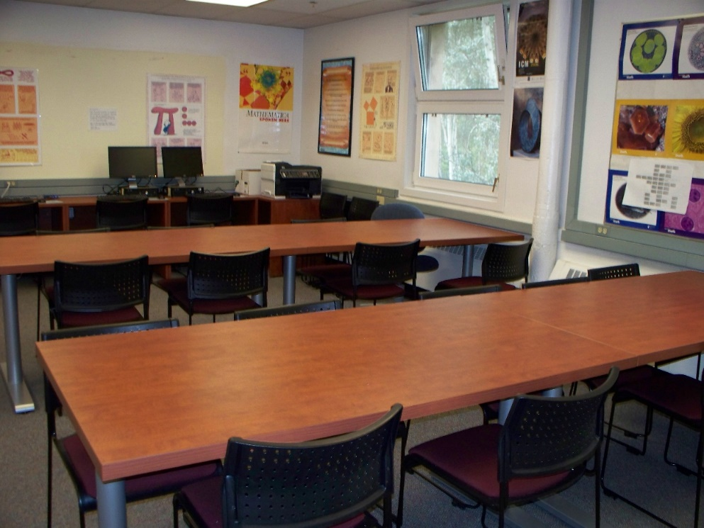
Math and Stat Lab
Kiosk and time keeping
Drop-in tutoring
Most semesters open 6 days a week
  8am-9pm M-F, 11am-5pm S
DEV math –upper division
Seats 36 students
1 tutor during slow times
2 tutors during peak times
Students log in/out to track usage
Tutors log in/out for time keeping

Slide 9
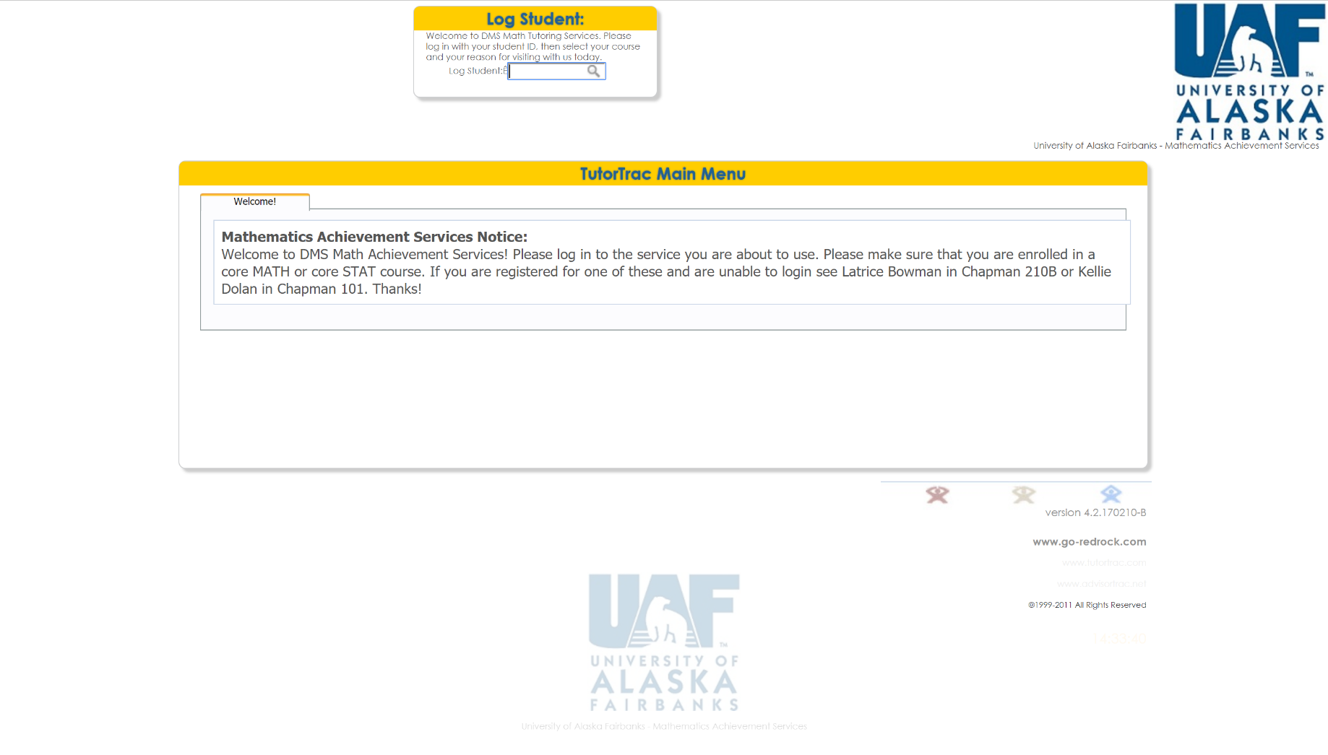

Slide 10
1-1 Tutoring
Appointments and Kiosk
By appointment but will take walk-ins
Primarily for core math and stat courses
Students can make 30min or 1hour appointments
Can book up to 1-hour per day
4 missed appointments locks students out, until they meet with coordinator
Track appointments for missed MB sessions
Some instructors are requiring 1-1 for students who miss a class
Send attendance reports to instructors
Tutors can check out Resources

Slide 11
Online Tutoring
Appointments and Drop-in
Tried various platforms
Current is NOT ideal
Currently using Blackboard Ultra
  Students make appointments in TutorTrac
  Have a Blackboard shell for all students enrolled in a math/stat course
  Students meet with the tutors in Blackboard
No kiosk for this as students are remote
Tutors often forget to log students into their appointments
No nice way to link student appointments with those in TutorTrac
No nice way to link tutor schedules with those in Tutor Trac

Slide 12
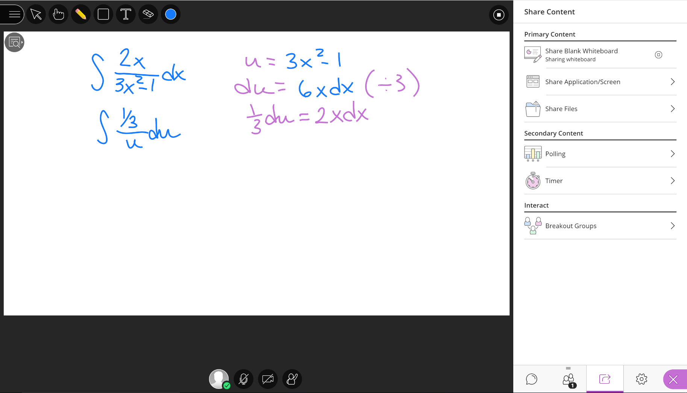

Slide 13
Course Specific Group Tutoring Attendance and reporting
Math 113 Numbers and Society
Math 114 Patterns and Society
Stat 200 Elementary Statistics
Stat 300 Statistics
Thought about
  Calculus
  Precalculus
Good for uncommon math stat courses that not all tutors are comfortable with
Problem solving
Some faculty use for extra credit
Some faculty use for extra review

Slide 14
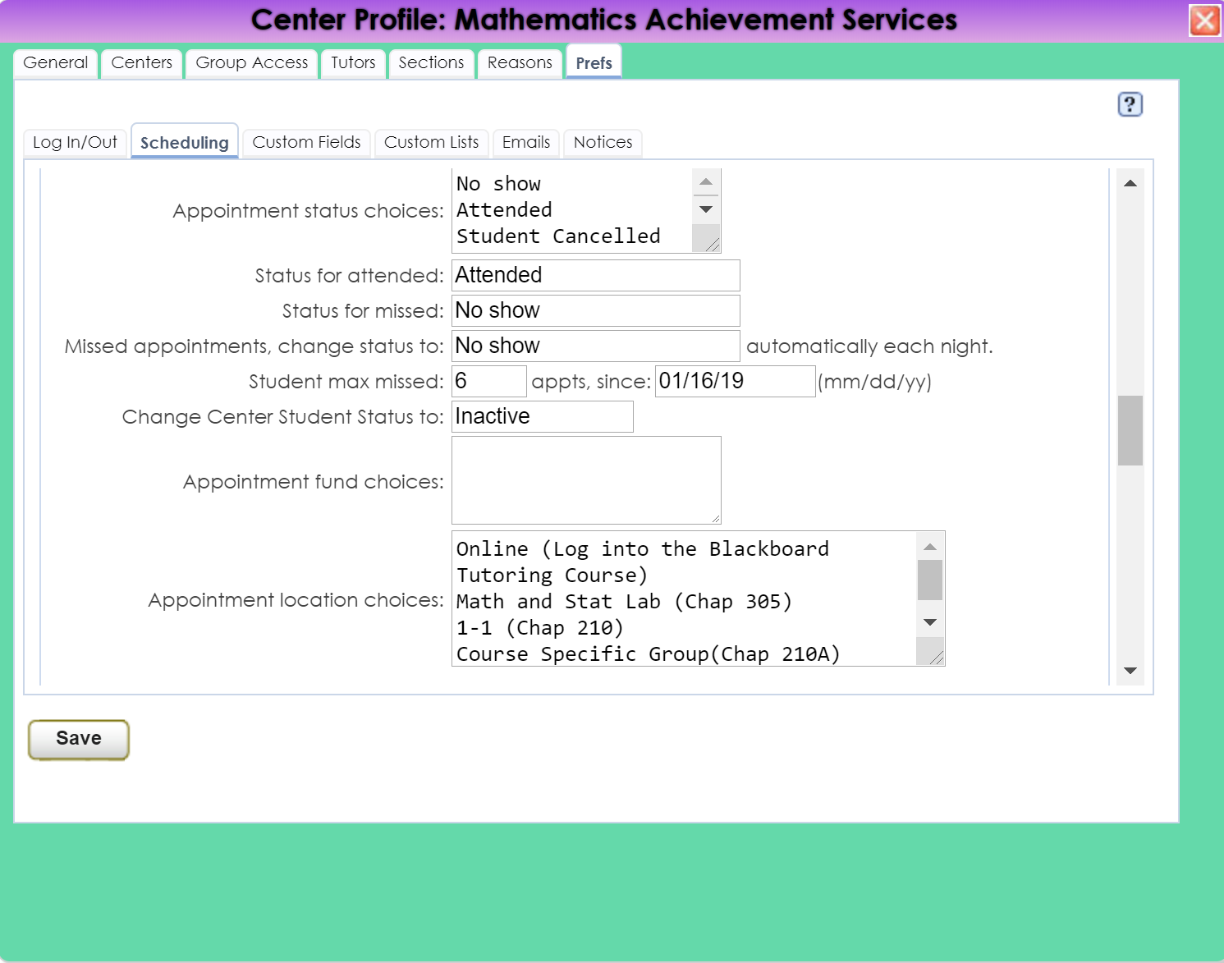

Slide 15
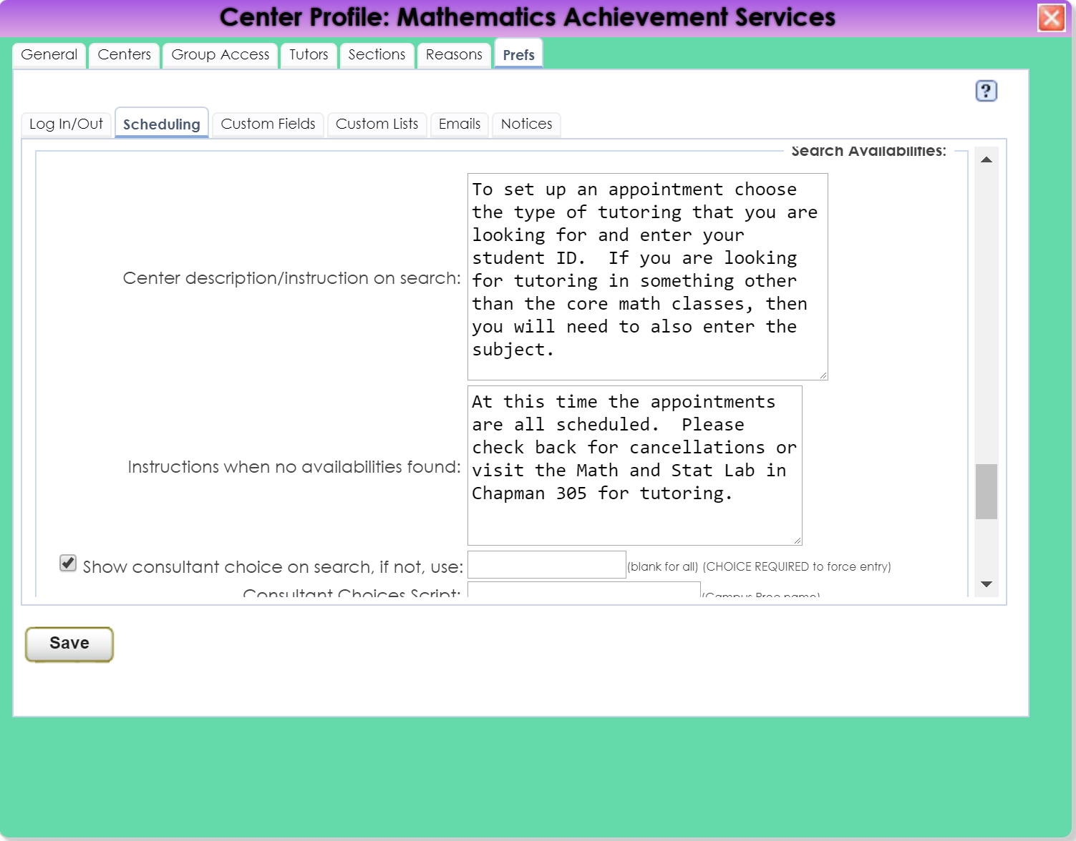

Slide 16
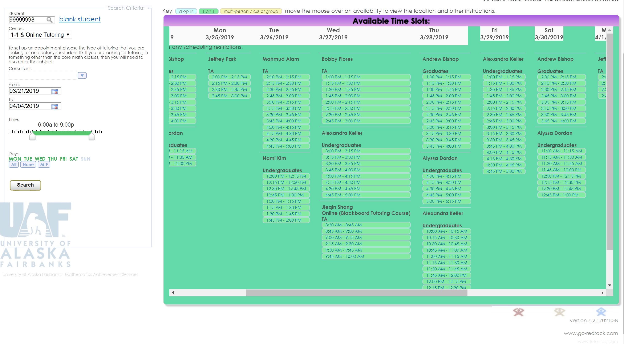

Slide 17
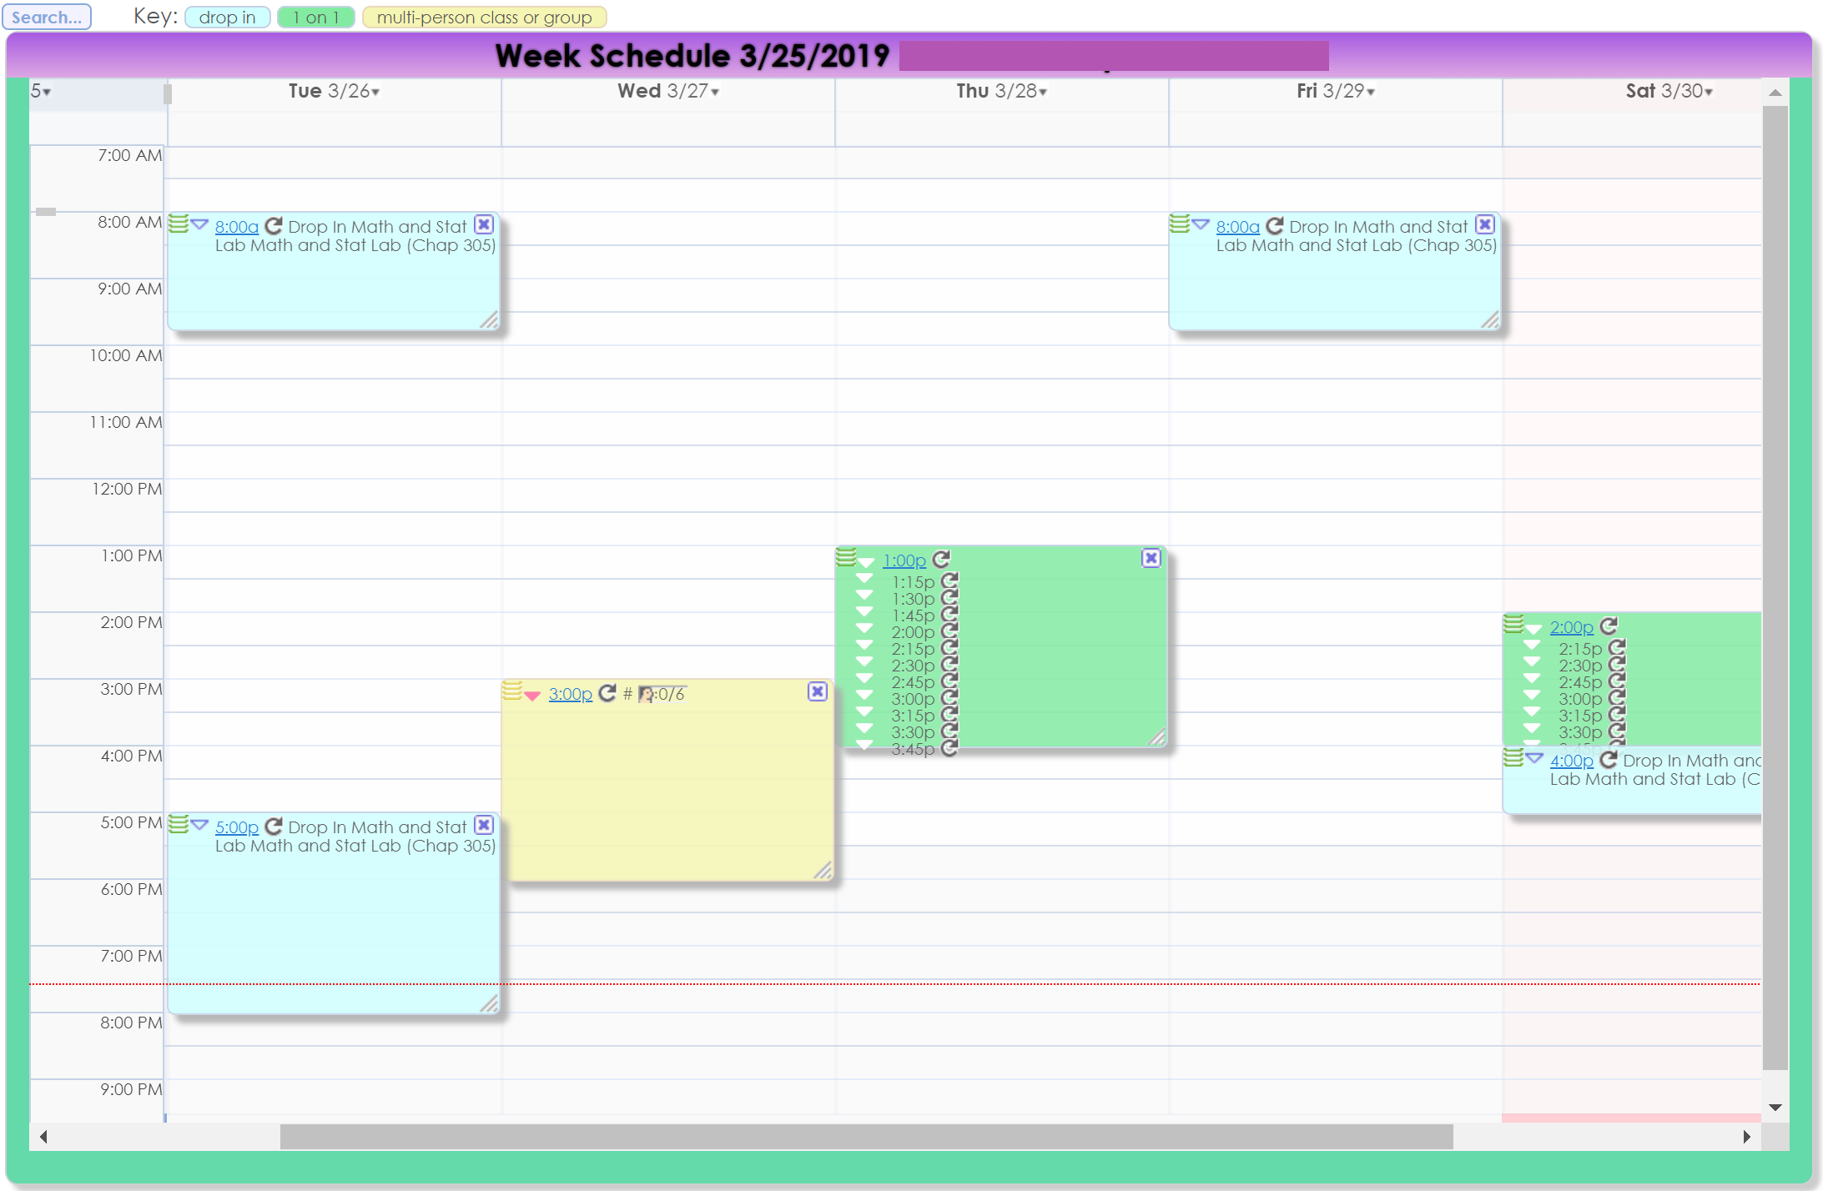

Slide 18
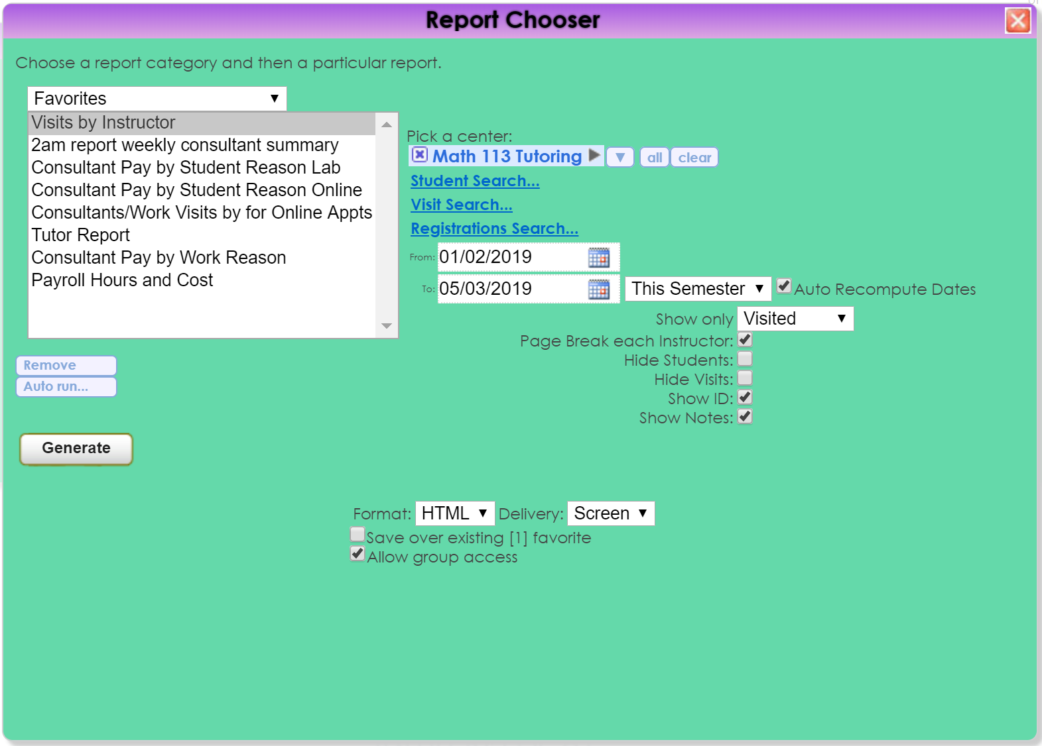

Slide 19
Grading- Tracking hours
For classes with 35 or more students
Depending on course level - 5 to 15 hours of grading a week
TAs and undergrad graders work at various times and places
Before
  Had trouble tracking hours
  No way to verify worked hours with faculty
Now
  Graders can log hours from anywhere and any time
  Have a way to report hours to faculty
  Have a way to support time sheets

Slide 20
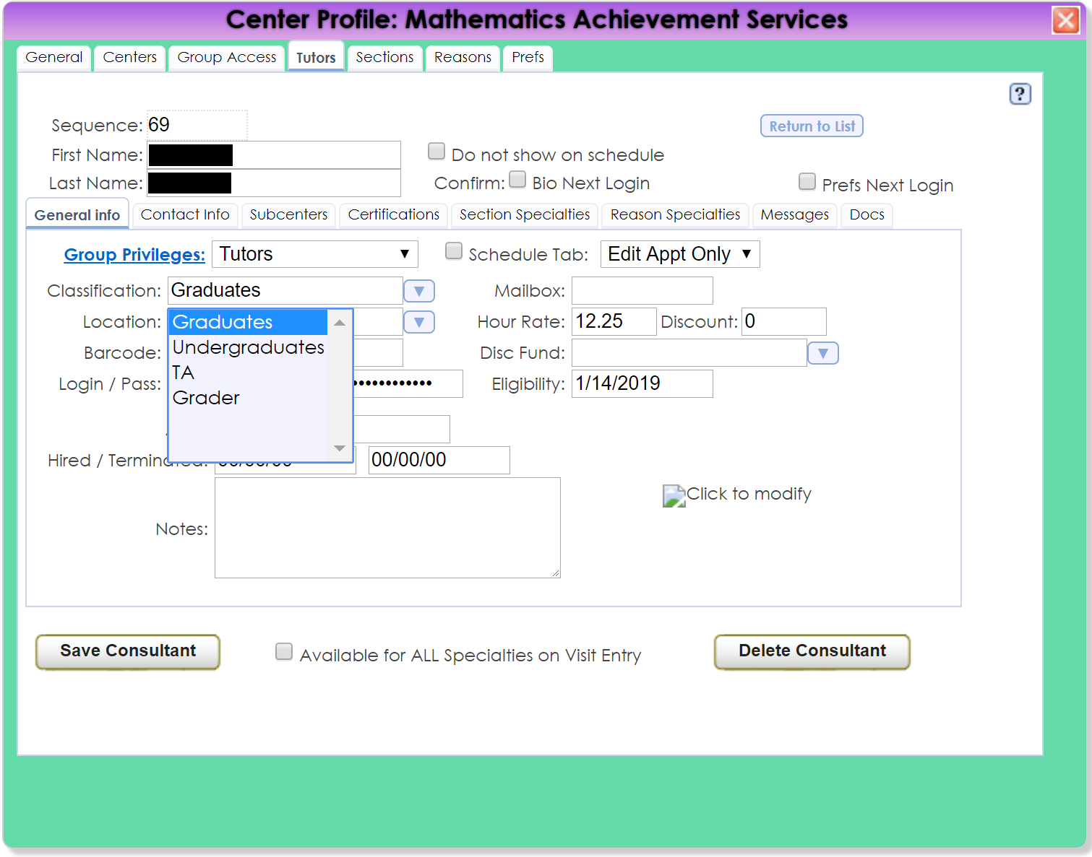

Slide 21
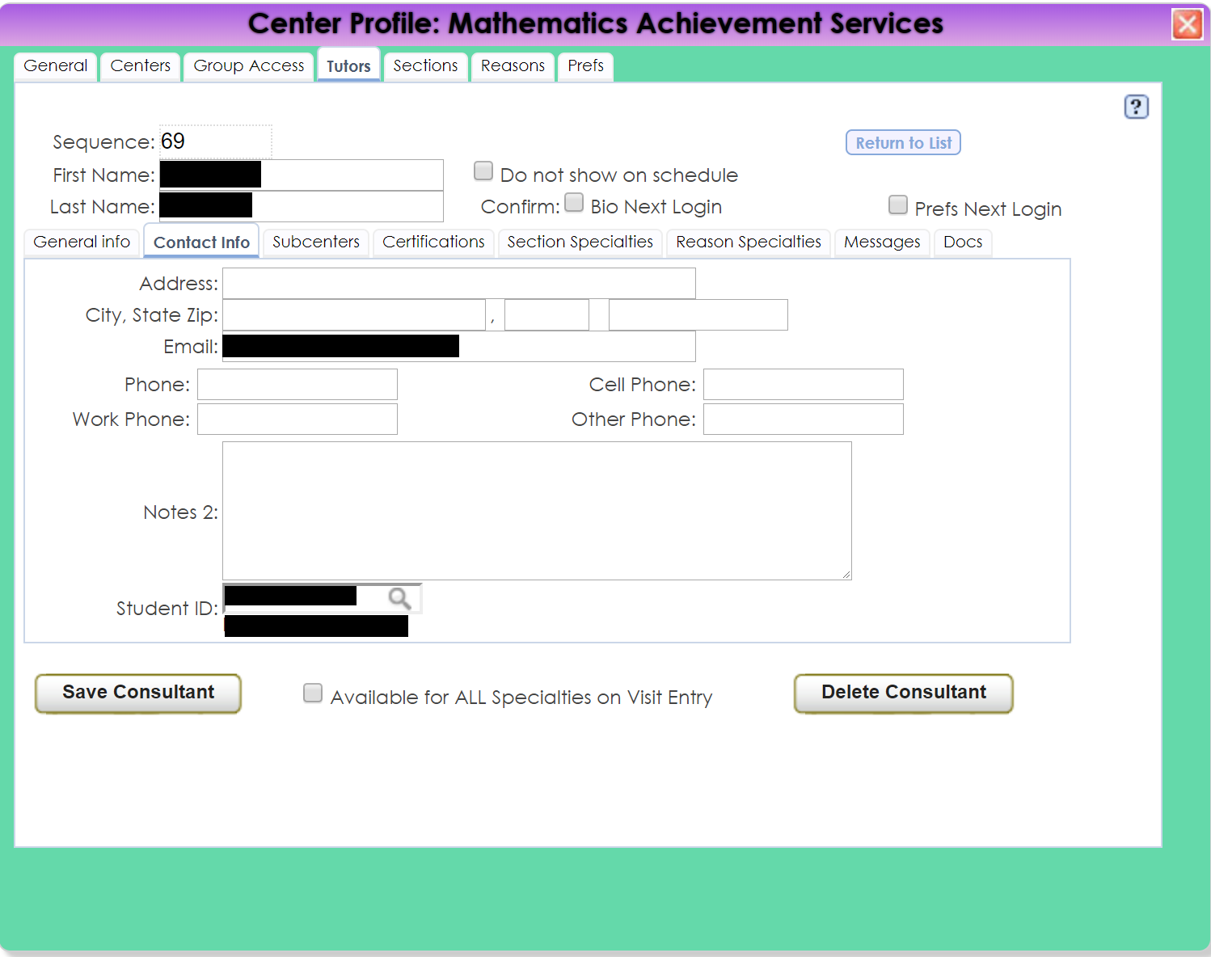

Slide 22
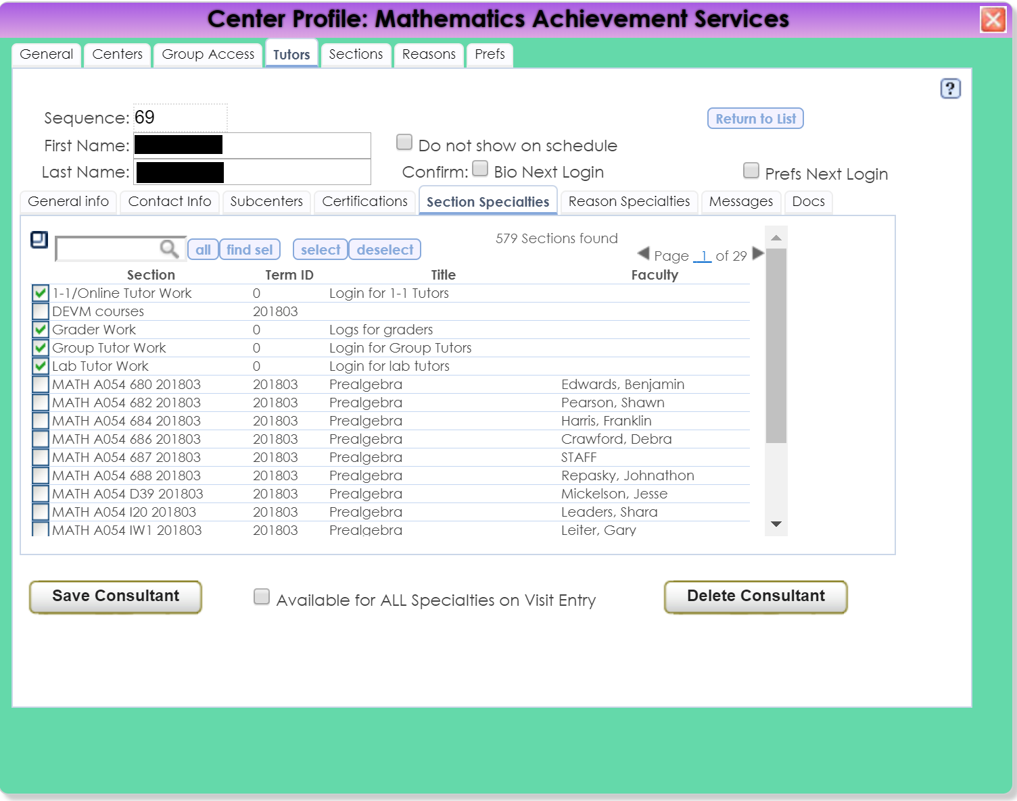

Slide 23
“Rentals”
Tracking and Inventory
What we “rent”
  Laptops
  Calculators
What we track
  Who the item is rented to
  How long they are renting the item
  Rental agreements
Students are notified automatically
Great for keeping notes on returns

Slide 24
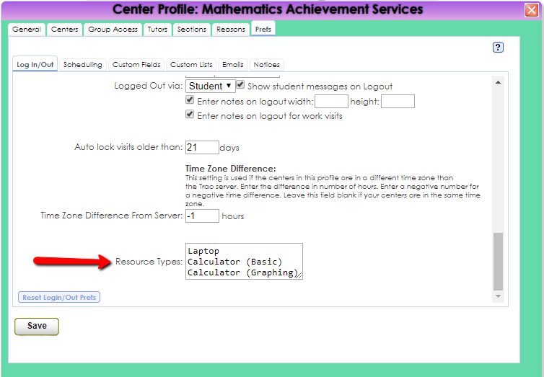

Slide 25
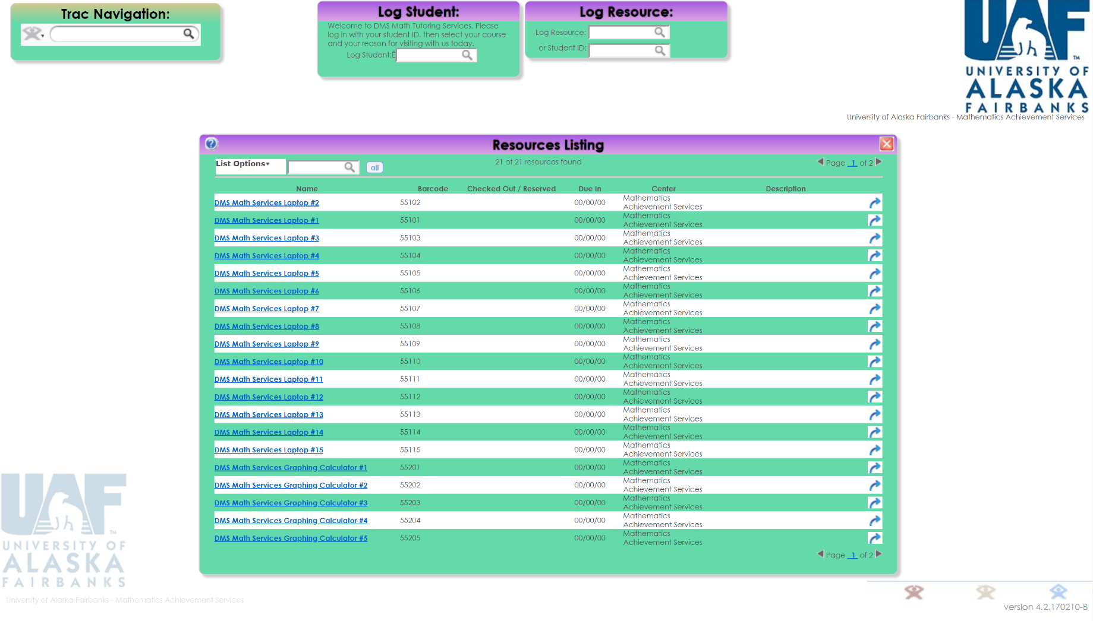

Slide 26
Tutor Trainings
Certifications
FERPA – renewed yearly
Title IX- Initial, supplement and a bi-yearly renewal
DMS tutor contracts – Semesterly
Nine UAF trainings – one time
Employee review - Yearly

Slide 27
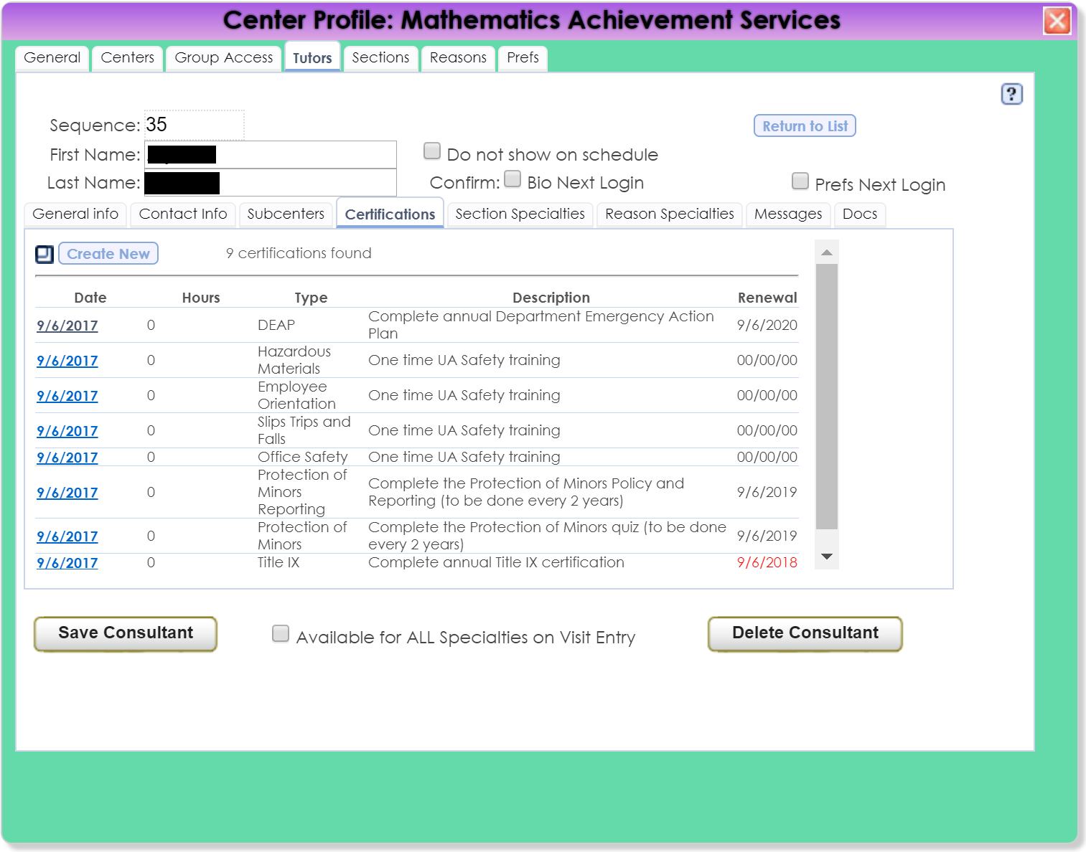

Slide 28
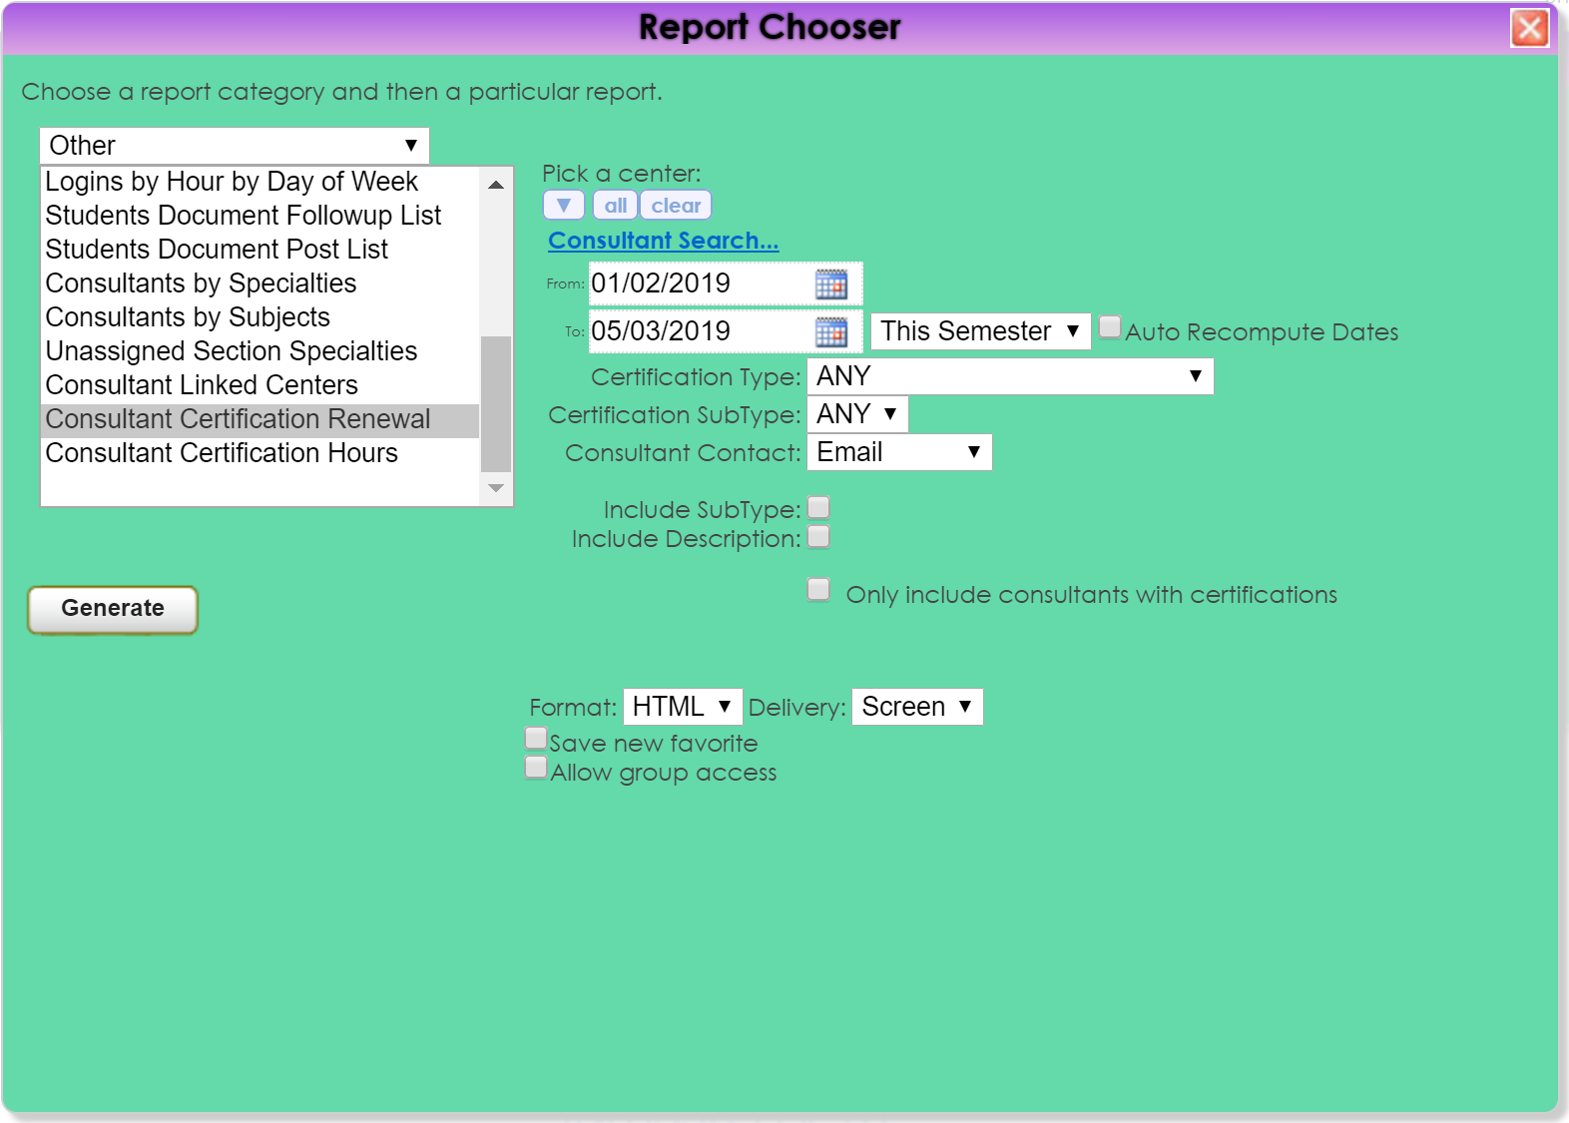

Slide 29
Were we go from here…
Incorporate more courses and programs
Currently working with Athletic Director to set up sessions for athletes
Working with other departments in DEVM/CNSM
TutorTrac Whiteboard for online tutoring!!!

Slide 30
Questions?

Slide 31
Thank you for attending this presentation
Latrice Bowman
University of Alaska Fairbanks
lnbowman@alaska.edu

